Slide 1
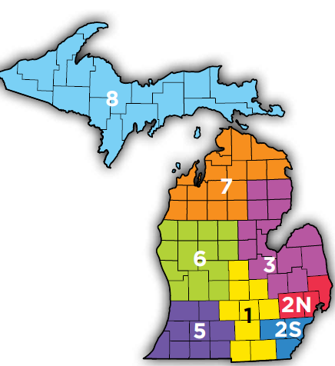
Michigan Healthcare Coalitions
Responses to Incidents or Events in last Year
Rick Drummer, R2N Regional Coordinator
May 5, 2025

Slide 2
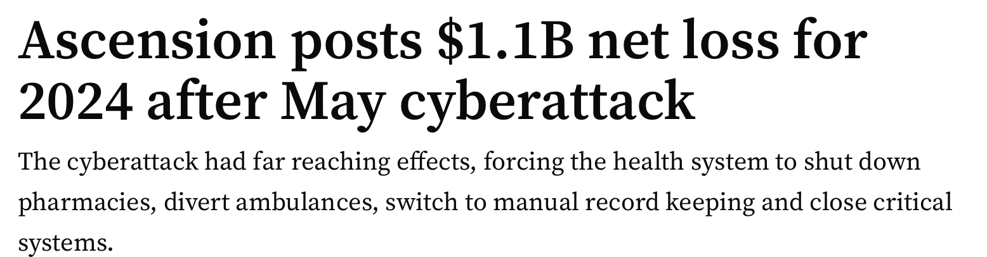
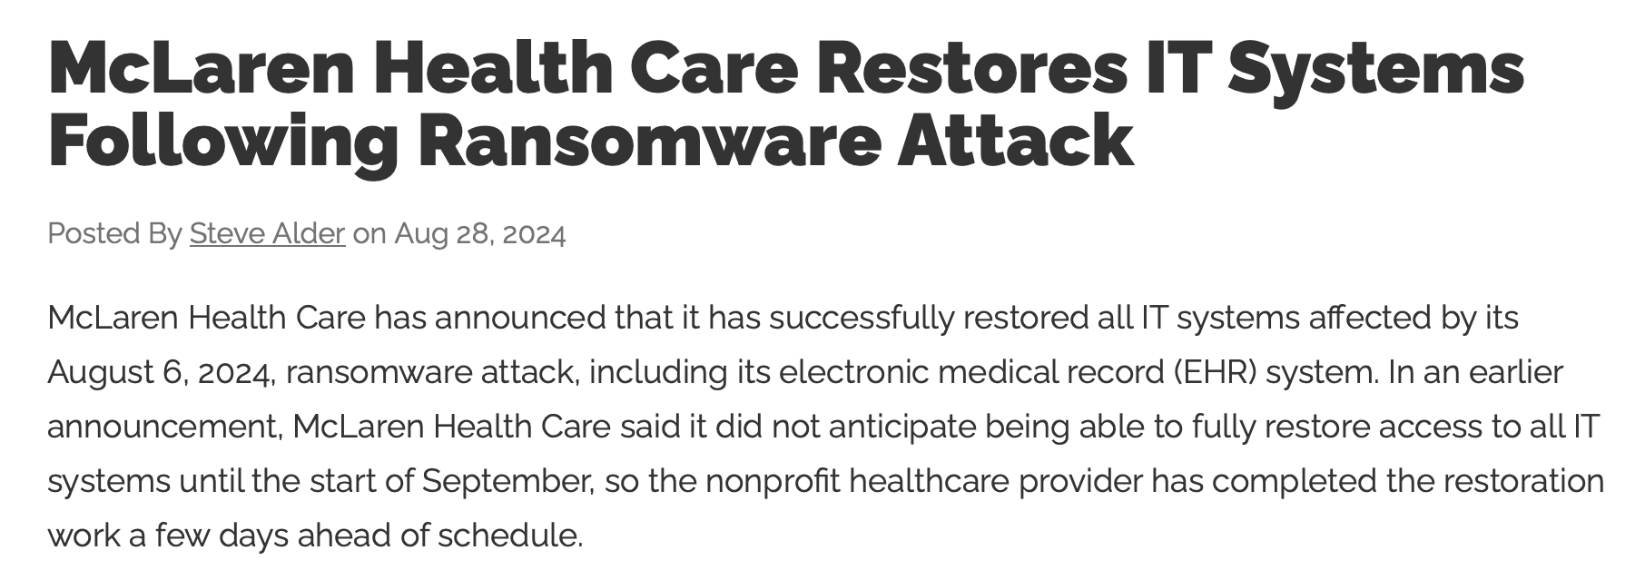
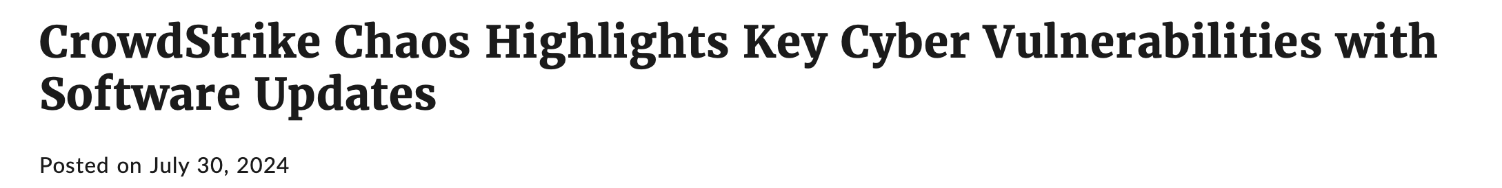
Cyber Attacks
MyMichigan Alma – R1and DEPR helped LARA form to change licensed beds
Ascension System – R1, R2N, R2S, R3, R5, R6 held regular conference calls with hospitals on status of all systems for several weeks
McLaren System – Situational awareness messages from HCCs on status and impacts on hospitals
XXX Hospital System – R3 provided situational awareness of potential cyber attack
CrowdStrike cyber attack – HCCs provided situational awareness updates to DEPR
Radios loaned out to Ascension Hospitals in Region 3

Slide 3
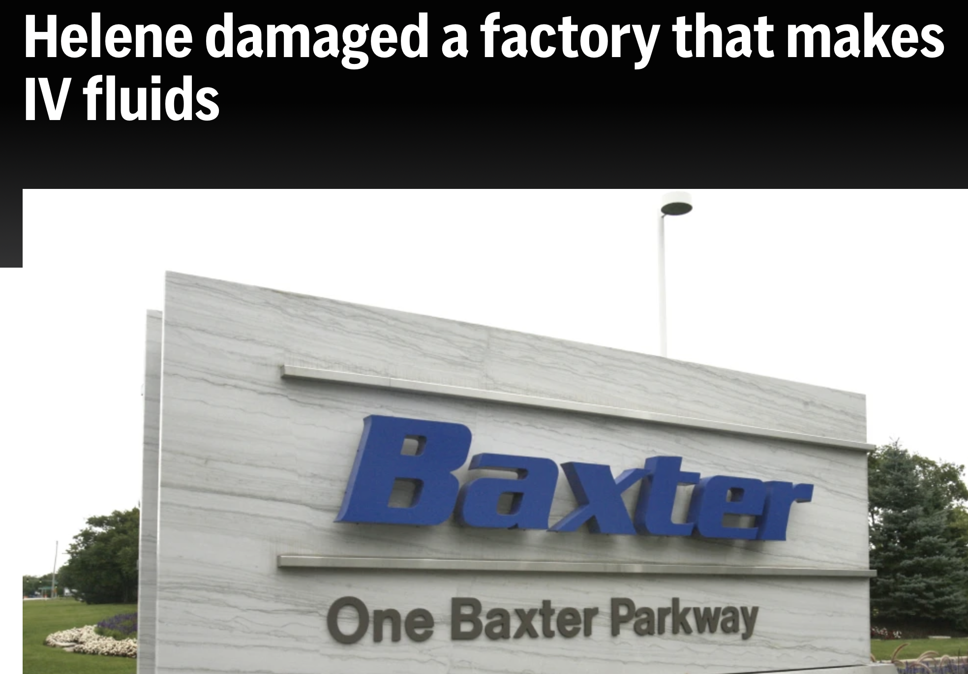
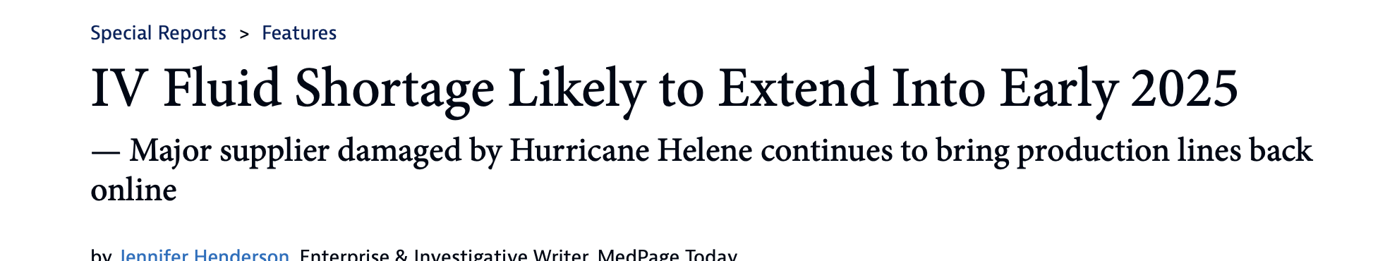
IV Shortages
Baxter North cove production facility in North Carolina hit by Hurricane Helene – All HCCs conducted regular meetings with hospital partners to follow status, provide conservation strategies sharing, and update DEPR. Many conference calls with the Regional Medical Coordination Centers.

Slide 4
Power Outages
Livingston Hospital – R1 conducted situational awareness briefings with emergency management to help escalate the need for quick restoration.
Many power outages sue to severe weather (see next slide).

Slide 5
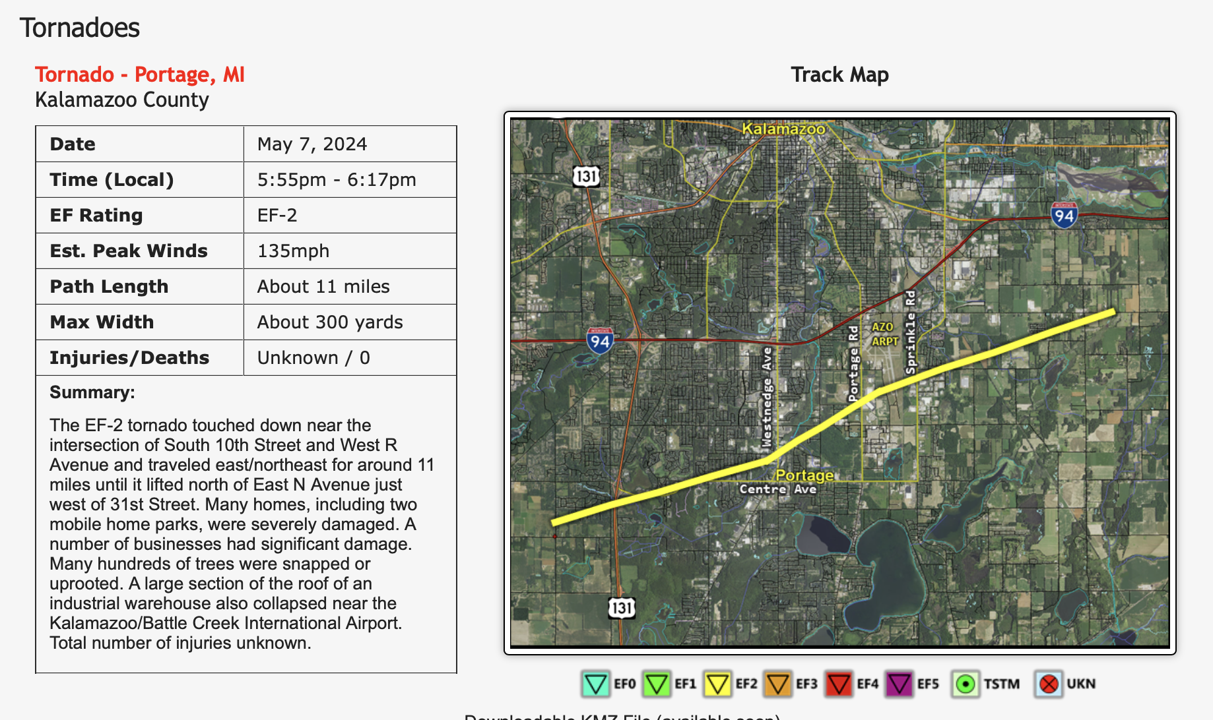
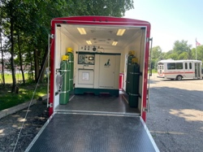
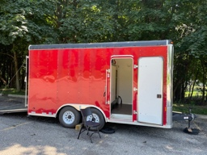
Severe Weather
During severe ice storms in upper lower peninsula, all other regions collaborated and helped including
  Oxygen generation trailers (MOG units) – R2N and R6
  Possible morgue or MERC (Mortuary Enhanced Remains Cooling) units – R2N and R1
  Regular calls and offers of assistance
  Region 8 worked with Wisconsin HCC on possible patient transfers due to bridge closure
Tornado in R5 – R5 RMCC stood up and supported by R6. Provided situational awareness.

Slide 6
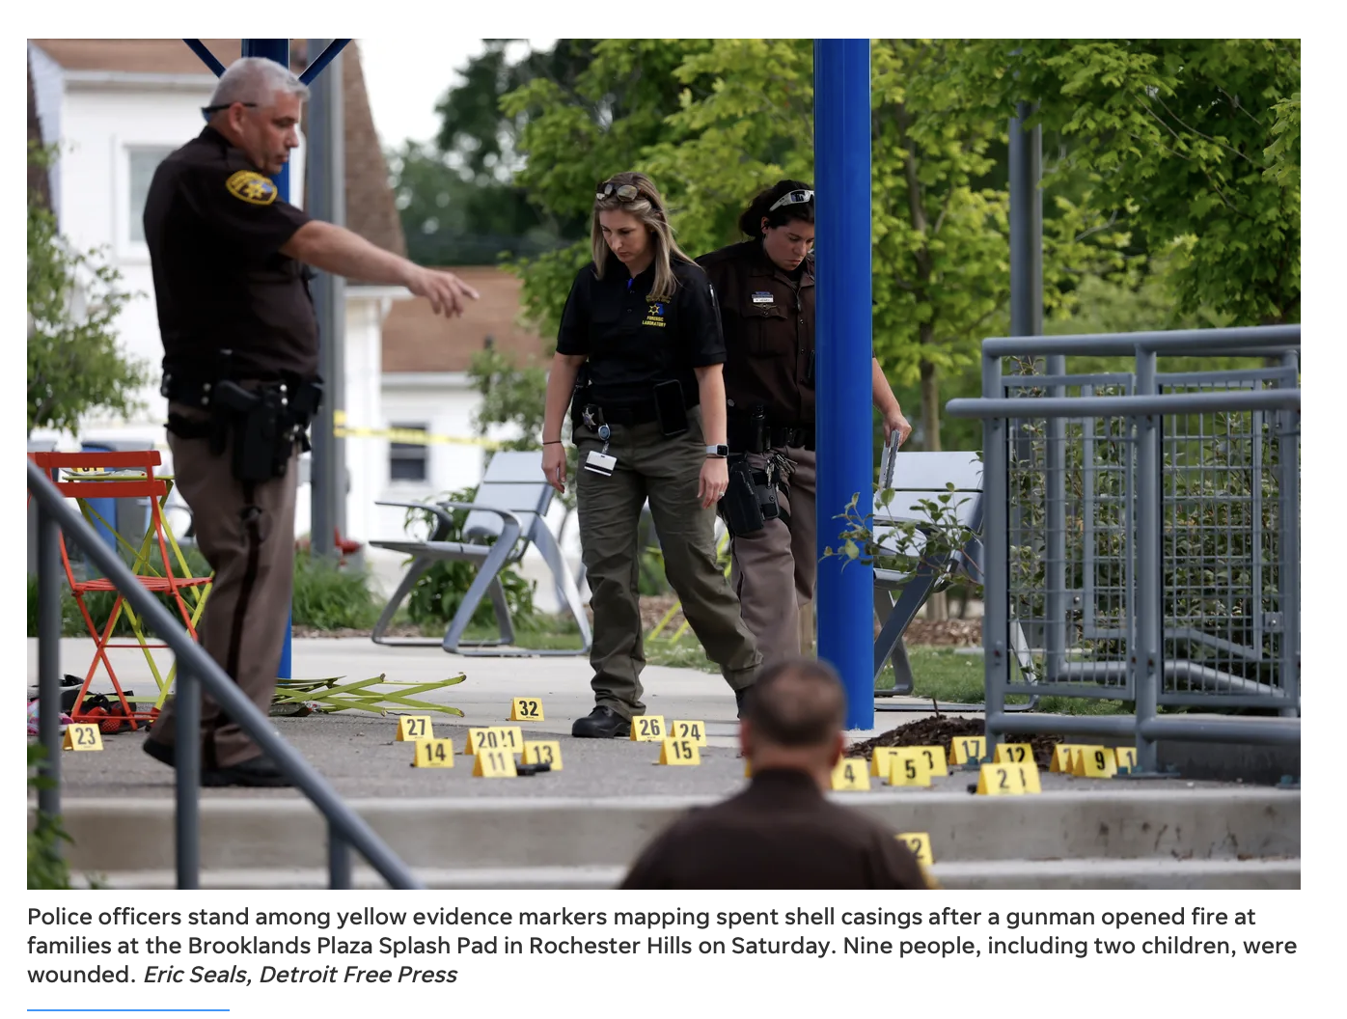

Active Assailant
Targeted shooting at Corewell Health Beaumont Troy Hospital – R2N provided situational awareness to local partners, the other seven HCCs, and DEPR
Brooklands Splash Pad – R2N provided situational awareness and status of hospital surge

Slide 7
Other Situational Awareness
McLaren struggling to get LTV1200 ventilator circuits – R3
MyMichigan Health issue with ventilators when they ran out of exhalation filters. Region 1, Region 3, and Region 6 notified and provided support.
Bridge Walk impacted Region 8 and Region 1 in coordination and pre-deployment of assets.
Blood culture tube shortage in Region 8.

Slide 8
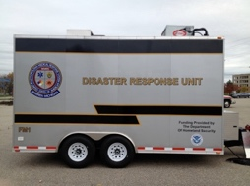
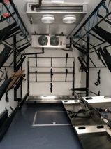
Uses of Regional Assets
MI-TESA deployed to Marquette, MI, for cold weather D-MORT exercise. Impacted Region 2 South and Region 8.
R2N morgue trailers deployed to hospitals for morgue capacity surges or morgue construction
R2N trailers and Stop the Bleed kits and tourniquets pre-deployed for large events

