Slide 1
Cold Weather Deployment Full Scale Exercise
Emilie Stack
EPC, Marquette County Health Department

Slide 2
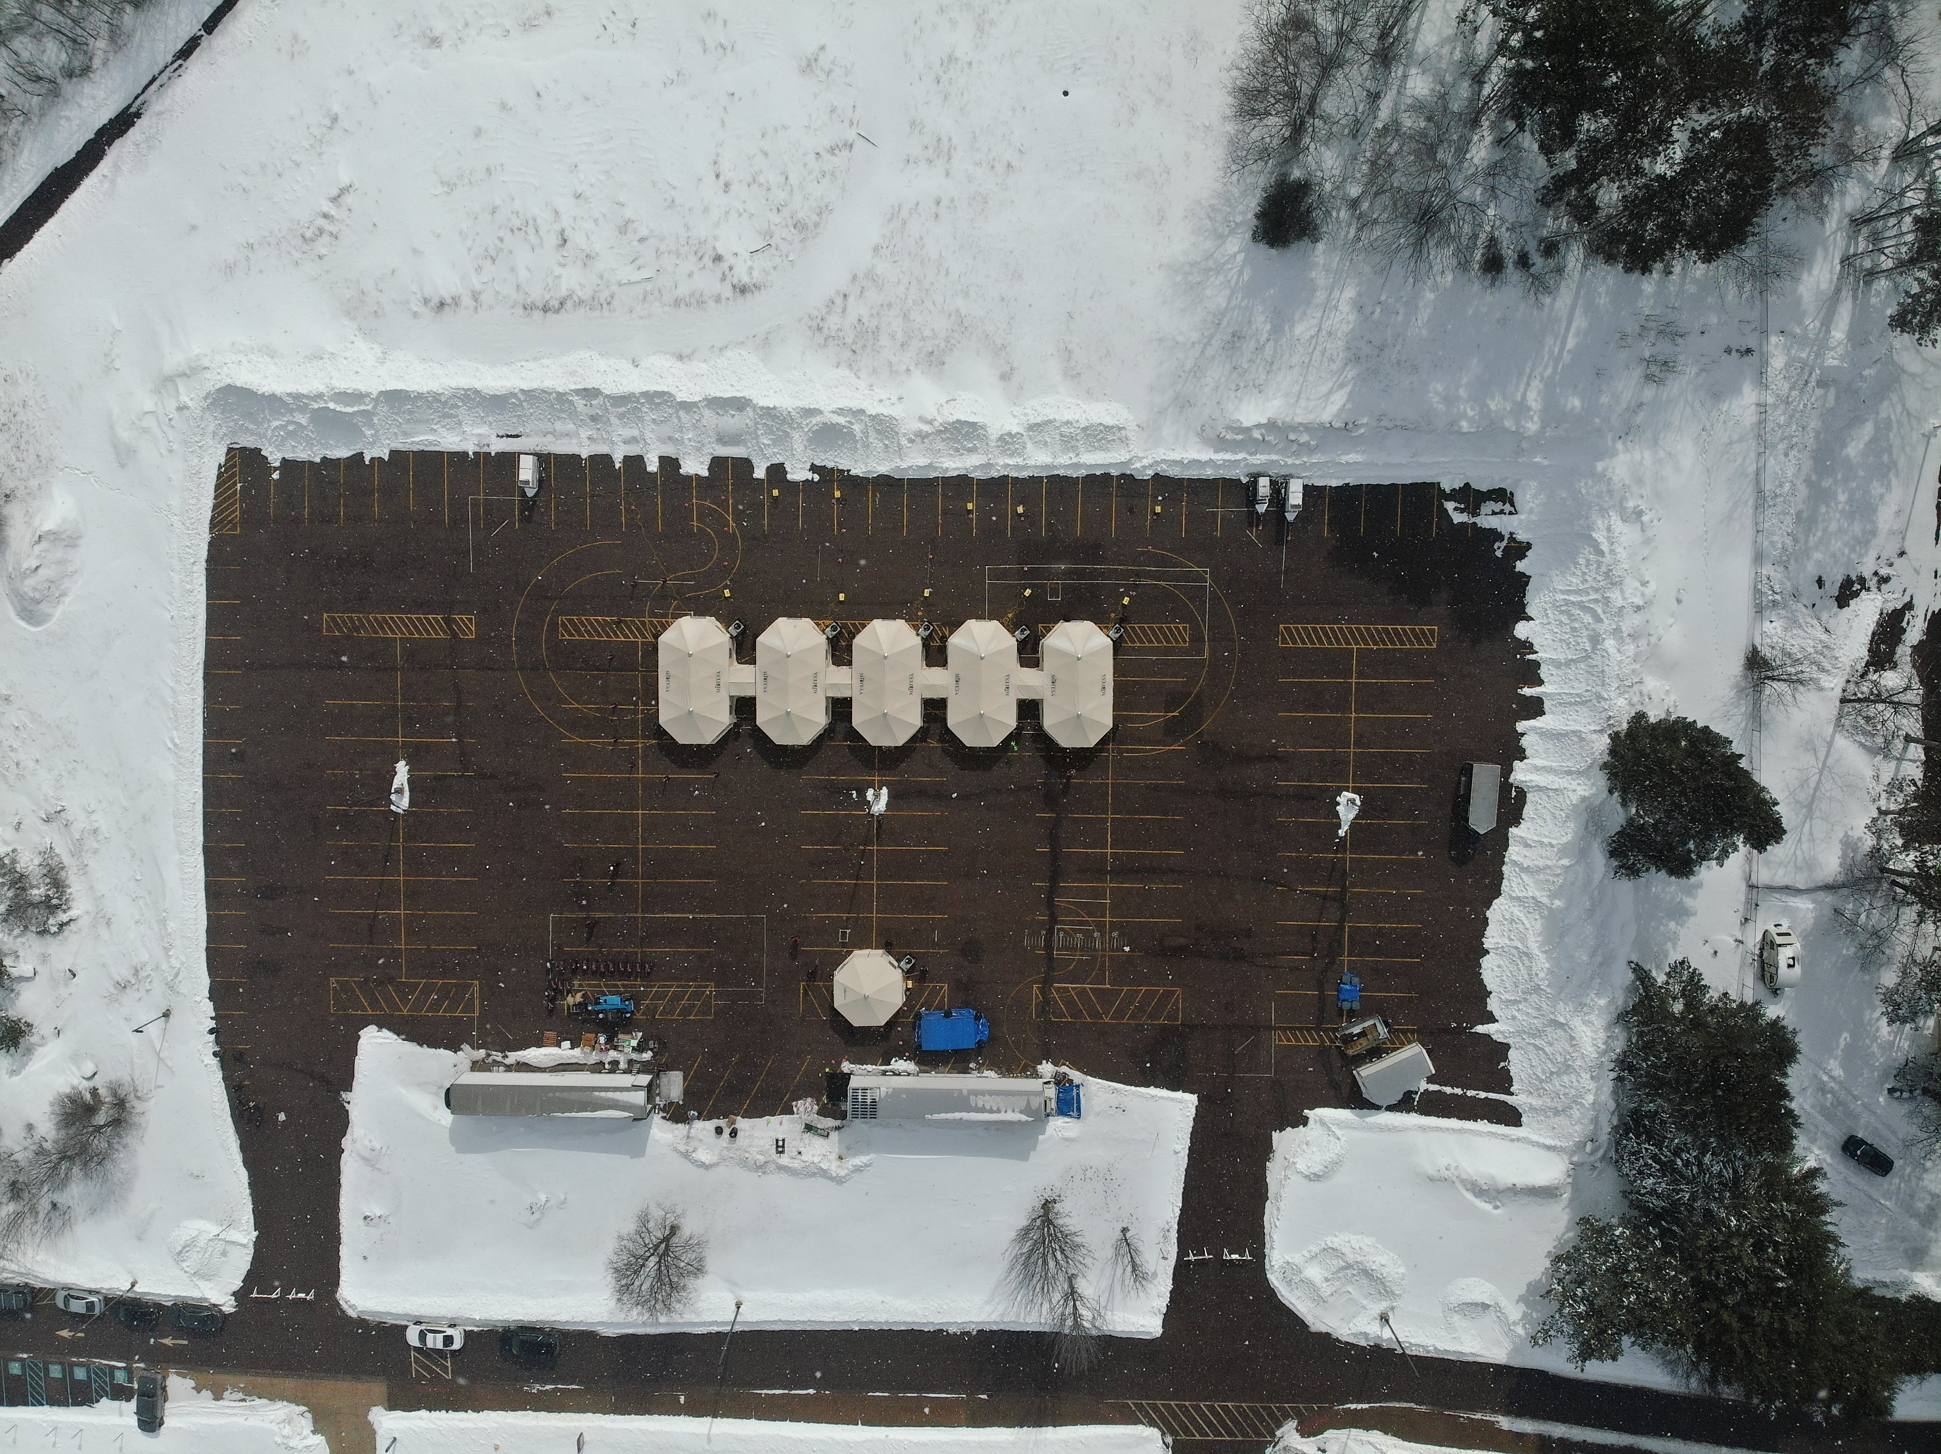
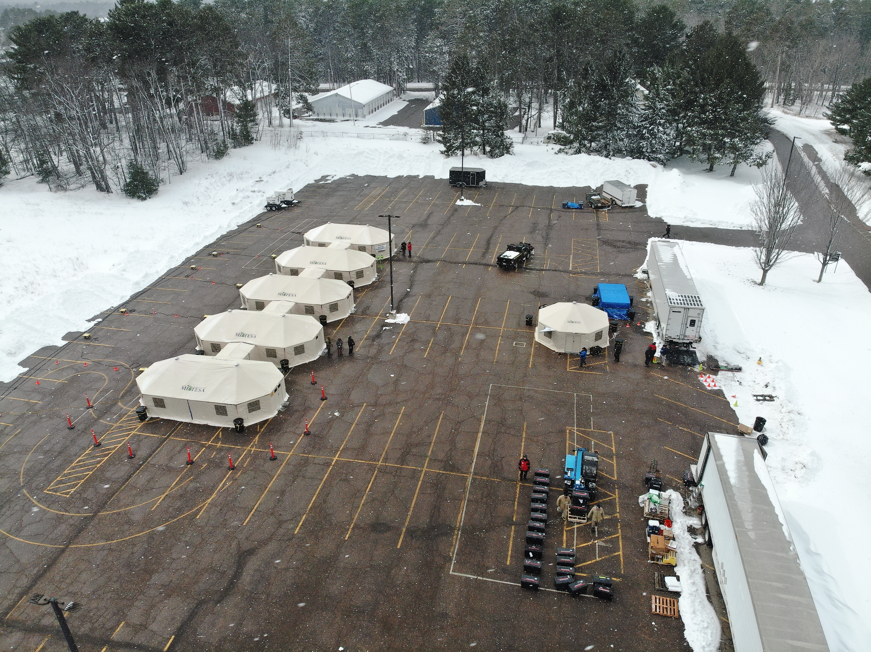
Cold Weather Deployment FSE
Notes:
Cold Weather Deployment Full Scale Exercise, March 3-10, 2025: the exercise focus was on the activation of the Michigan Transportable Emergency Surge Assistance (MI-TESA) medical unit and the Michigan Mortuary Response Team (MI-MORT) Disaster Portable Morgue Unit (DPMU) to deploy outdoor in cold weather conditions to support the Federal Disaster Mortuary Response Team Region V (DMORT V) in response to a natural disaster mass fatality incident.

Slide 3
Exercise Objectives
- Demonstrate the ability to coordinate and support federal DMORT V deployment with MI-TESA/MI-MORT resources according to standard operating procedures.
- Deploy the MI-TESA and MI-MORT DPMU to safely set-up and maintain medical tents and mortuary equipment in a cold weather environment.
- Validate the ability of responders to operate in tented and cold weather conditions.
- Validate capability to operate the DPMU medical and electronic equipment in cold weather conditions.
- Evaluate the capability to demobilize MI-TESA tent structures and MI-MORT morgue equipment in cold weather conditions.

Slide 4
Partnerships
DMORT V
MI-MORT
MDHHS
Region 8 HCC
FBI
Region 8 2S HCC
Region 8 Trauma
Region 8 EPCs
National Weather Service
Medical Examiner Offices
Michigan State Police
Marquette County Emergency Management
National Ski Patrol
Northern Michigan University
Salvation Army
Midway Rentals
Road Commission
Central Dispatch
Local LE/Fire/EMS
MI-TESA
Notes:
MI-TESA, DMORT V, MI-MORT, Federal Bureau of Investigation (FBI), MDHHS, Region 8 Healthcare Coalition, Region 2S Healthcare Coalition, National Ski Patrol, National Weather Service, Medical Examiner Offices, Michigan State Police, Region 8 Emergency Preparedness Coordinators
Local - Emergency Management, LHD, Northern Michigan University, Salvation Army, Law Enforcement, Midway Rentals, road commission, central dispatch, Fire/EMS

Slide 5
Lessons Learned
- Key missing partnerships (local hospitals and medical examiner services)
- Local process for requesting units
- Site location selection
- Weather conditions/equipment
- Communication
Notes:
Medical Examiner
At the time Marquette County was contracting with the Michigan Institute of Forensic Science and Medicine (MIFSM). Their phone number wasn’t working due them being in the process of switching phone carriers and the process was taking longer than expected. Had to connect with them via email. We didn’t have a close working relationship with our medical examiner so it would have altered the process
We are now contracting with Dickinson County’s Medical Examiner
Requesting process
On Monday, March 3rd we tested the MI-MORT requesting process. Since we didn’t have a local medical examiner on board, we couldn’t truly test this at a local level. We also need to have a plan/procedures in place to do this.
Local hospitals – were invited to the exercise but didn’t have much involvement in the exercise. An improvement would be to incorporate them into the requesting process and coordination calls.
Site location
Level surface (TESA’s equipment needs to be on a near-perfect level surface), road restrictions (weight restrictions were a consideration during the planning process)
Weather conditions
Wind (significant concern during setup and strikedown. Safe practical wind speed is much lower than a fully assembled tents wind rating.
Fabric canvas was restricted due to the cold so heat guns needed to be used
Couldn’t fit the pins in the metal poles due to the cold so they needed hammers
Generators: it was cheaper to rent locally rather than transport generators
Communication
A phased deployment of personnel may be best to incorporate into planning such as MI-MORT and DMORT could be deployed at a later time after MI-TESA set-up
Communication worked well via 800MHz and connected to a TAC channel was exercised and worked. It was a planning consideration to switch to a TAC channel

Slide 6
