Slide 1
Environmental Health Resources During Incident Operations
May 5, 2025
Jerry Tiernan and Jordan Mangeno MDHHS Environmental Health Bureau

Slide 2

Environmental Health (EH) Bureau
Chemical Planning and Response
Toxicology and Assessment
Environmental Health Surveillance
Biomonitoring, Epidemiology and Response
Environmental Epidemiology and Analytics
Residential Environmental Services
Lead Certification and Compliance Assurance
Community Education and Outreach
Care Coordination
Division of Toxicology and Response
Division of Epidemiology, Data Analytics and Evaluation
Division of Environmental Community Services
Notes:
The Bureau is supported by toxicologists, epidemiologists, health educators, engineers, geologists, and project specialists who lend their expertise to projects throughout the bureau.
This shows the various sections housed under the environmental health bureau umbrella, wide variety of focuses, and there is significant collaboration between these sections to carry out EHB programs and projects
Centralizing communication activities in the section ensures consistent application of the best available social science and public health practices throughout EHB with the goal of informing residents of actions that can be taken to prevent or limit exposures to environmental hazards.

Slide 3
Environmental Health Bureau Role
Identify
Investigate
Intervene
First public health step is to determine if a reported public health threat is credible and requires an immediate public health action or public health investigation.
Public health investigation is to quantify and characterize exposure and risk of harm to the identified at-risk population, which may result in further public health actions.
Public health actions are interventions that happen as soon as possible once knowledge of a credible threat is identified and refined through quantification of the risk of harm. Therefore, intervention happens in parallel to Identify and Investigate in a time-critical manner to reduce, eliminate or prevent harm.
Notes:
Environmental Health Threats

Slide 4
EH Bureau Operational Structure
Environmental Health programs align with Environmental Public Health threats.
EH Bureau professionals are organized by skill sets within units and are assigned to EH Program Core Teams or provide support by conducting assignments for EH programs.
EH Program Core Teams are multi-disciplinary and provide professional leadership in running the EH Program to achieve Michigan Public Health Code obligations to protect the people of Michigan from environmental hazards.
Notes:
The Bureau hires professional staff with advanced degrees and training. Those professional work in muti-disciplinary Program Core Teams, that provide the proactive planning as well as ensuring time-critical response. RPU serves to support the EH Program Core teams during emergencies to all public health response to happen faster while still completing all the necessary documentation for explaining actions under the public health code.

Slide 5

Incident Response
The EH Bureau has planning and incident command structure experience in applying environmental public health assistance to incidents and events.
Notes:
We are one piece of the response puzzle –
Environmental Health Threats

Slide 6
Preparedness

Slide 7
Preparedness –
Response Planning Unit
Environmental Health Bureau
Division of Toxicology and Response
Chemical Planning and Response Section
Response Planning Unit
Engaged training and exercise partner.
Available for planning technical assistance.
Collaborates with Public Health Emergency Preparedness program and external partners.
Notes:
Goal - Response Planning Unit within CPRS collaborates across EHB to act as the bureau’s focal point for environmental public health emergency and time-critical response planning utilizing the National Incident Management System (NIMS) framework and all-hazard approaches.
Response Planning Unit (RPU) serves as a resource to coordinate EHB’s incident preparedness and response activities to environmental, chemical, and physical hazards, The unit collaborates with local, state, and federal agencies to assure hazards are identified, investigated and interventions are in place to mitigate or remediate hazards for the people of Michigan including those most vulnerable.
The unit serves as the EHB’s focal point towards sustaining and increasing the Bureau's capabilities for prevention, mitigation, preparedness, response, and recovery activities through implementation of the NIMS Framework and works in collaboration with the MDHHS Bureau of Emergency Preparedness, E.M.S. and Systems of Care (BEPESoC).

Slide 8
Preparedness - Environmental Health Operator Program
Maintains a toll-free public hotline.
Provides information on planned public health actions to callers.
Available on state working days.
8 a.m. – 5 p.m.
Trained on current environmental health issues.
800-648-6942
Notes:
The toll-free hotline is open 8AM – 5PM on state working days – however these hours can be adjusted for incident needs. Operators act as a call center to connect residents to information or to subject matter experts within the bureau.

Slide 9
Preparedness – Environmental Health Navigator Program
Shares information and resources to protect community members’ health and reduce stress related to environmental contamination.
Provides residents with public health information developed for the response.
Trained to understand the environmental health issue in preparation for each community response.
Notes:
EHB has staff that are trained to provide just-in time instructions/information directly 1:1 with affected residences. These Navigators go out into the community and serve as a one stop location for communication with residences directly affected. i.e. alternate living arrangements or bottled water. Provide education/information directly to individuals or small groups, as necessary, to implement planned public health actions to reduce exposure (or protect health).

Slide 10
Response

Slide 11
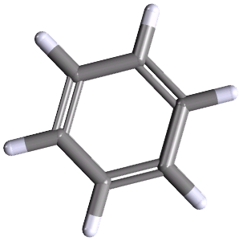
Response – Toxicological Assistance
Toxicologists are a technical resource to all parties on environmental exposures for health questions.
Upon evaluation of data, if there is a public health concern, they can develop public health recommendations and develop an action plan to mitigate the public health concern.
Notes:
Toxicologist - review of data, they can assist with making public health recommendations

Slide 12
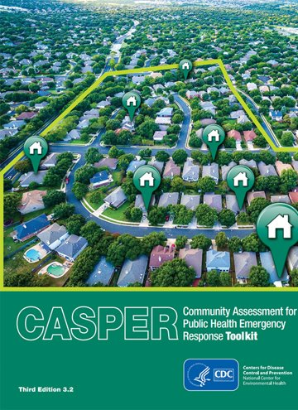
Response – Disaster Epidemiology
Implementation of rapid needs assessments.
Analyze real-time emergency department and ambulance data.
Share recommendations for future prevention and mitigation strategies.
Notes:
EHB epidemiologists can provide technical assistance: ​
Implementation of rapid needs assessments​
Community Assessment for Public Health Emergency Response (CASPER)​
ATSDR’s Assessment for Chemical Exposure (ACE) ​
Surveillance activities

Slide 13

Response – Sampling
Supports scheduling and sampling of impacted communities.
Partners with regulatory agencies.
Collects and provides analysis of environmental health data.
Provides results to those affected.
Environmental and Biological Sampling
and
Public Health Drinking Water Program
Notes:
Environmental and Biological Sampling
Designs appropriate sample collection and data analysis methods.
Supports sample collection in impacted communities.
Analyzes the data and provides results to residents and the community.
The Biomonitoring, Epidemiology and Response Section (BEaRS) collects and assesses exposure and biomonitoring data for the purpose of identifying human exposure to environmental chemicals. The section works together to design methods to collect and analyze data, as well as share findings that result from biomonitoring surveillance (like blood and urine samples) and other environmental epidemiology investigations.
Sanitarians coordinate with toxicologists to sample various environmental agents, if necessary.​
Sanitarians can: ​
Determine lab capabilities, lab capacity, and distance from sampling site to determine best lab for analyzing the sample. ​
Offer staffing surge capacity to complete sampling with additional sanitarians. ​
Help with lab results and data collection.
Drinking water and Environmental Sampling Unit
Scheduling and sampling drinking water supply sites.
Assisting with the development and distribution of educational materials and outreach for both public and private drinking water supplies.
Following-up with regulatory agencies to determine public health impact of required corrective measures at sites of contamination.
Drafting reports on the hydraulic and hydrologic phases of affected watersheds at sites of contamination.
Reviewing data as part of the Public Health Drinking Water Program to assist in the determination of the need for and appropriateness of responses needing to be or have been completed to protect public health.

Slide 14


Response – Data Analysis
Environmental Data Summary and Risk Assessment
Epidemiological Data
Mapping and Spatial Data Analysis
EH Bureau has data scientists, geologists, GIS specialists, epidemiologists and toxicologists available to assist.

Slide 15
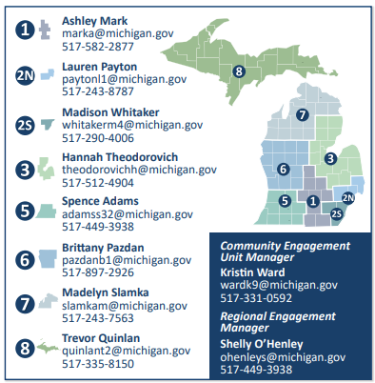
Response – Community Education and Outreach
Creates and distributes public health educational materials to individuals.
Plans, attends and coordinates community outreach events to educate individuals or small groups on environmental health related messaging.
Connects response partners to community partners.
Craft incident-specific products for use by response teams.
Notes:
From MDHHS Website (Below)
Community Engagement​
Community Engagement (CE) serves communities by being a liaison between MDHHS-DEH and community-based organizations. Community Engagement Coordinators build and maintain regional connections with local organizations to respond to the community’s needs. ​
​
Community Outreach​
Community Outreach (CO) plans, attends, and coordinates events to share information to ensure residents, especially those at risk, are aware of and can take action to end or prevent environmental, chemical, and physical hazards. ​
​

Slide 16

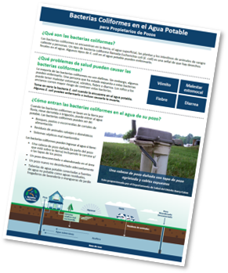

Response – Health Education
Health educators (HE) can develop a communication strategy with plain language and accessible messaging for the public.
This includes assisting in the creation of messages for:
Fact sheets.
Talking points.
Letters and flyers.
Press releases.
More, as deemed appropriate.
Notes:
Health Education​
Health Education (HE) develops overall communication strategies, including health messaging and material products based on the incident such as talking points, fact sheets, social media posts, and feedback for the community’s website, as requested. They ensure the materials are accessible to specific target audiences.
Health Education –can support your HD in the development comms strategy. Can assist with the development of fact sheets, recruitment materials, PR, whatever is needed to put out into the community.

Slide 17
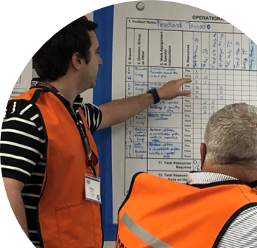
Response – Incident Emergency Management
Certified Professional Emergency Manager (PEM) staff.
Emergency operations center support.
Incident action plan development.

Slide 18
Additional Services
Long-term sampling efforts.
Health studies.
Lead services.
Lead Professional Certification.
Provides lead services and prevention programs to residents.
Emerging health threats.
Notes:
The Division of Environmental Community Services is comprised of Lead Certification and Compliance Assurance Section, Residential Environmental Services Section, and Care Coordination Section.
Lead Certification and Compliance Assurance Section
The purpose of the Lead Certification and Compliance Assurance Section is to protect public health through lead-based paint training, certification and regulatory compliance while ensuring internal quality standards.
Residential Environmental Services and Care Coordination Services
These sections implements and oversees the programs that provide lead services to Michigan citizens. This includes home abatement, childhood blood lead testing, and additional services for children who have been identified with an elevated blood lead level.

Slide 19
Case Study

Slide 20
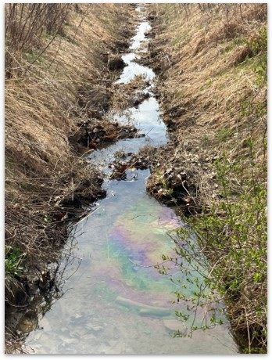
Case Study: Ottawa Lake Diesel Spill
Incident date: Late March 2024.
Whiteford Township, Monroe County, MI.
Concern: Diesel fuel oil leak near the intersection of US-23 and US-223 posed a significant threat of contaminants entering private drinking water wells.
Volume of spill: 31,201 gallons of pure diesel. ​

Slide 21







Case Study: Ottawa Lake Diesel Spill
Aided ATLAS in collection of water samples.
Implemented a call center.
Provided technical assistance with communications.
Centralized collection and management of data.
Supported through toxicology analysis and interpretation of test results.
Developed a long-term sampling plan with MCHD.
Collaborated and assisted Monroe County Health Department with result sharing to Michigan residents.
Notes:
Emphasis is on collaboration with Monroe County Health Department on these activities – this was not just EHB efforts
Facilitation of operational support provided to MCHD through daily operational calls.
EHB sanitarians and environmental health navigators partnered with ATLAS Technical Consultants LLC (Atlas) to collect water samples from private drinking water wells across Whiteford Township, Michigan.
The establishment and management of a EHB call center to receive calls from Whiteford Township residents who requested to have their private drinking water well sampled.
Technical assistance with communications, specifically press release reviews and recommendations, issued by Monroe County Health Department.
Centralized collection of data and management of data, which was made available to Monroe County Health Department though the implementation of the Chemical Planning and Response Section - Data System (CPRS-DS).
Community outreach and communication support during the conduction of two town halls that were completed on April 10th, 2024.
Toxicology support through analysis and interpretation of test results and communicating those results with residents.
Resident outreach to report “non-detects” results was provided through the EHB Call Center Operators.
The development of a long-term sampling plan to conduct assurance testing into the future as onsite/offsite investigations and remedial efforts are completed.

Slide 22
Case Study: Ottawa Lake Diesel Spill
Strength – key findings:
Initial risk identification and collaboration.
Response Planning Unit (RPU) activation.
Virtual operations center implementation.
Area for improvement – key findings:
Communication.
Incident management structure.
Call center operations.
Notes:
Information is from the Ottawa Lake After-Action Report
The implementation of risk identification and planning by public health officials facilitated an effective response to a diesel spill.
The RPU was activated to coordinate public health services, providing a structured approach to water testing and operational management in an emergency.
Establishing a virtual operations center enhanced data access and information tracking, improving situational awareness and coordination during public health emergencies.
During water sampling, communication issues resulted in confusion about appointment times among residents. There is a need for improved coordination and standardized communication protocols.
Early response efforts encountered challenges due to unclear roles and communication protocols, indicating a need for more defined roles, responsibilities, and comprehensive training in the Incident Command System (ICS).
The call center was activated without formal policies, leading to operational gaps. Establishing formal protocols and guidelines could enhance its efficiency

Slide 23

Contact Information
Jerry Tiernan, CPG Chemical Planning and Response Section Manager 517-388-7471 tiernang@michigan.gov
CPRS
Matthew Bursley, MPH, PEM Response Planning Unit Manager 517-243-9812 bursleym@michigan.gov
RPU
Jordan Mangeno, FPEM
Response Planning Unit Analyst
517-243-8298 mangneoj@michigan.gov
RPU

