Slide 1

What is an Integrated Preparedness Plan and an
Integrated Preparedness Planning Workshop?
Damon Obiden, EMT-P, I/C, PEM
Notes:
We would like to extend a special thanks to Will Moorhead of All Clear Emergency Management Group for sharing his expertise and his slides with us. For a review of the presentation, please watch Will’s training on YouTube at Integrated Preparedness Plan Training Module.

Slide 2
Learning Objectives
After completing the session participants will:
Have an increased understanding of the concept of an IPP.
Understand the concept of an IPPW and how to facilitate an IPPW.
Understand the resources available to guide development of an IPP and facilitation of an IPPW.
Notes:
The presenter explains that participants will understand the IPP concept, the IPPW process, and resources available to support development and facilitation.
Concept, facilitation, resources.
Follow through one of the tools for the creation of the IPPW. Give tips and tricks to use the tool.

Slide 3

Checkbox Versus Value
Intentional, Accurate, Meaningful
Time, Talent, Treasure
Notes:
The purpose of this IPPW kickoff meeting is to ensure we are all working from a common baseline, that we understand the IPP process, and we clearly define expectations for the steps ahead.
While part of the IPP process fulfills a compliance requirement, or “checks a box”, our greater goal is to connect the many training and exercise requirements in a way that highlights their logical relationships. We want to make the process make sense, demonstrate how each step adds value, and show how intentional, accurate, and meaningful planning not only builds on previous work but also lays a stronger foundation for what comes next.
It seems that the program requirements are stacked one atop the other, with almost no time allotted between them, and these requirements have become more scripted. So, it is very easy to feel like we are checking boxes. Take a moment, step back and remember that our responsibility is to prepare for when bad things happen and guide the situation toward its most positive outcome.
To reach our goal, it takes dedicated time, expertise or talent of people, and prudent and effective use of our funds, or treasure.

Slide 4
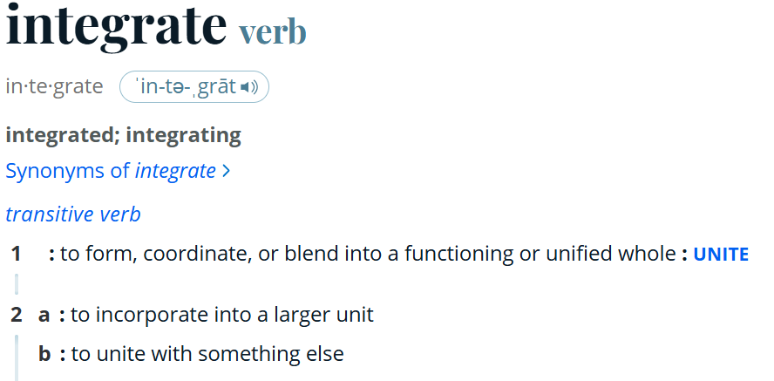
Checkbox Versus Value
Notes:
Integrating requires that we look at all our grant requirements, our AARs and Ips from real world events and exercises, our risk assessments and then form a Plan to address how we get from where we are now to where we want to be.
Our goal is to coordinate training and exercises to address shared priorities.

Slide 5
Integration
Our end goals will be to integrate across:
disciplines
organizations
jurisdictions
program requirements
identified gaps
known and potential risks

Slide 6

Integrated Preparedness Overview
HOLD a meeting
SET priorities
DEVELOP a plan document
CREATE a multi-year schedule
ESTABLISH program reporting
BUILD relationships
What guides our process?
Notes:
What guides our process?

Slide 7
Background
HSEEP (Homeland Security Exercise and Evaluation Program)
HSEEP provides a set of guiding principles for exercise and evaluation programs, as well as a common approach to exercise program management, design and development, exercise performance, evaluation, and improvement planning.
Homeland Security Exercise and Evaluation Program | FEMA.gov
Notes:
Using the common approach of HSEEP (Homeland Security Exercise and Evaluation Program), the whole community can develop, execute, and evaluate exercises that address the preparedness priorities. These priorities are informed by risk and capability assessments, findings, corrective actions from previous events, and external requirements. These priorities guide the overall direction of an exercise program and the design and development of individual exercises.
https://www.fema.gov/emergency-managers/national-preparedness/exercises/hseep

Slide 8
Background
HSEEP doctrine updated in 2020
Intention to make doctrine and templates easier for new users and involve all levels of decision makers.
Capabilities now refers to whole community preparedness goals, not just the core capabilities in the National Preparedness Goal.
Updated the definition of “Senior Leaders” to include all decision makers, not just appointed/elected officials.
Notes:
https://www.fema.gov/sites/default/files/2020-04/HSEEP-Frequently-Asked-Questions-feb2020.pdf
Whole community preparedness focus.

Slide 9
Background
TEPW/MYTEP vs. IPPW/IPP
Training and Exercise Plan Workshop (TEPW)
Multi-Year Training and Exercise Plan (MYTEP)
Integrated Preparedness Plan Workshop (IPPW)
Integrated Preparedness Plan (IPP)
According to FEMA, The TEPW/TEP model did not support integration of risk assessments, planning efforts, grant priorities, and other preparedness activities to drive exercise activities.

Slide 10
Background
TEPW/MYTEP vs. IPPW/IPP
To address that gap, FEMA developed the IPPW/IPP model to establish the strategy and structure for an exercise program, in addition to broader preparedness efforts, while setting the foundation for the planning, conduct, and evaluation of individual exercises.

Slide 11
Background
Terminology Variance
LHDs and PHEP hold an IPPW, and develop an IPP with a multi-year schedule (due 3/31/2026)
HCCs have the Readiness Assessment and develop a Readiness plan which includes a multi-year TEP.
(due in October with final submission 11/30/2025)
HPP has the Strategic Plan and develops a multi-year TEP.

Slide 12
Background
National Preparedness Goal
The National Preparedness Goal identifies 5 mission areas, and 32 core capabilities*** intended to assist everyone who has a role in achieving all the elements in the Goal.
Notes:
*** Note that the Core Capabilities are being migrated to 8 National Health Care Preparedness and Response Capabilities.

Slide 13
National Preparedness Goal
Mission areas
Prevention
Protection
Mitigation
Response
Recovery
Notes:
Prevention
Prevent, avoid or stop an imminent, threatened or actual act of terrorism.
Protection
Protect our citizens, residents, visitors, and assets against the greatest threats and hazards in a manner that allows our interests, aspirations and way of life to thrive.
Mitigation
Reduce the loss of life and property by lessening the impact of future disasters.
Response
Respond quickly to save lives, protect property and the environment, and meet basic human needs in the aftermath of a catastrophic incident.
Recovery
Recover through a focus on the timely restoration, strengthening and revitalization of infrastructure, housing and a sustainable economy, as well as the health, social, cultural, historic and environmental fabric of communities affected by a catastrophic incident.

Slide 14
National Preparedness Goal
Capabilities ***
The 32 core capabilities, established in the National Preparedness Goal, are grouped across the relevant five mission areas. Some core capabilities fall within a single mission area, while others apply to multiple or all mission areas.
National Preparedness Goal - Second Edition
Notes:
*** Note that the Capabilities from 2017-2022 are in the process of being updated to the 8 NHCPR Capabilities cited 2 slides after this one.
Mission Areas and Core Capabilities | FEMA.gov (Note that these capabilities are changing to the National Health Care Preparedness and Response Capabilities)
https://www.fema.gov/emergency-managers/national-preparedness/mission-core-capabilities.

Slide 15
32 FEMA Core Capabilities
Planning Public Information and Warning Operational Coordination Forensics and Attribution Intelligence and Information Sharing Interdiction and Disruption Screening, Search, and Detection Access Control and Identity Verification | Physical Protective Measures Cybersecurity Supply Chain Integrity and Security Risk Management for Protection Programs and Activities Risk and Disaster Resilience Assessment Community Resilience Long-term Vulnerability Reduction Threats and Hazards Identification Environmental Response/Health and Safety | Critical Transportation Situational Assessment Fatality Management Services Fire Management and Suppression Infrastructure Systems Logistics and Supply Chain Management Mass Care Services Mass Search and Rescue | On-Scene Security, Protection, and Law Enforcement Operational Communications Public Health, Healthcare, and Emergency Medical Services Health and Social Services Economic Recovery Natural and Cultural Resource Housing
Notes:
Mission Areas and Core Capabilities | FEMA.gov (Note that these capabilities are changing to the National Health Care Preparedness and Response Capabilities)
https://www.fema.gov/emergency-managers/national-preparedness/mission-core-capabilities.
Review HSEEP ExPlan Template and HSEEP AAR Template to see mission areas and capabilities.

Slide 16
8 National Health Care Preparedness and Response Capabilities
Incident Management and Coordination
Information Management
Patient Movement and Distribution
Workforce
Resources
Operational Continuity
Specialty Care
Community Integration
National Health Care Preparedness and Response Capabilities
(NHCPR Capabilities)
Notes:
^{1.} The primary audiences for the Capabilities are the health care workforce (both clinical and nonclinical), health care facility and health care system leaders and emergency managers, EMS leaders and operations supervisors, HCCs and other health care coordinating entities, health care organizations, professional societies and organizations, non-governmental organizations, and federal and SLTT emergency response and public health planners. ^{2.} For the purposes of the Capabilities, the “health care delivery system” refers to all organizations and people whose purpose is to promote, restore, optimize, or maintain health. While there is currently no single national health care system, the Capabilities uses “health care delivery system” to capture the broad spectrum of those who work towards meeting the health care needs of individuals and the population at large.
https://aspr.hhs.gov/HealthCareReadiness/guidance/Pages/Frequently-Asked-Questions.aspx

Slide 17
15 PHEP Capabilities
Community Preparedness Community Recovery Emergency Operations Center Emergency Public Information and Warning Fatality Management Information Sharing Mass Care Medical Countermeasure Dispensing and Administration | Medical Material Management and Distribution Medical Surge Nonpharmaceutical Interventions Public Health Laboratory Testing Public Health Surveillance and Epidemiological Investigation Responder Safety and Health Volunteer Management
Notes:
Public Health Emergency Preparedness and Response Capabilities: National Standards for State, Local, Tribal, and Territorial Public Health—October 2018
https://www.cdc.gov/readiness/media/pdfs/CDC_PreparednesResponseCapabilities_October2018_Final_508.pdf
Honeycomb – Lens for capabilities

Slide 18
HPP/HCC Capabilities
Foundation for Health Care and Medical Readiness Health Care and Medical Response Coordination Continuity of Health Care Service Delivery Medical Surge (FY2024-2028 HPP NOFO) “You and your HCC(s) will use both the upcoming National Health Care Preparedness and Response Capabilities and the Health Care Preparedness and Response Capabilities for Health Care Coalitions (formerly known as the 2017 – 2022 Health Care Preparedness and Response Capabilities) to support your approach to whole community health care readiness. Both sets of capabilities serve as a guide for HCCs and the health care delivery system as a whole, and the activities laid out in this cooperative agreement support you and your HCC(s) in achieving them. You and your HCC(s) will use the capabilities as a guide for how you may work with partners across the health care delivery system to prepare for, respond to, and recover from emergencies and disasters.”
Notes:
Health Care Preparedness and Response Capabilities for Health Care Coalitions (2017-2022)
https://aspr.hhs.gov/HealthCareReadiness/guidance/Documents/Health-Care-Preparedness-and-Response-Capabilities-for-Health-Care-Coalitions.pdf
Under each capability for the program are objectives and activities which expound upon the intended action.

Slide 19
Preparedness Priorities
Preparedness Priorities
Preparedness priorities are identified and continually re-evaluated as part of the exercise planning process. These priorities are informed by the current plan, risk and capability assessments, exercise improvement findings, corrective actions from previous events, and external requirements.
Notes:
Once a list of priorities is established for a multi-year period, the list will be periodically reviewed. If a priority is fully addressed, it may fall off the list, if a new gap is identified, it may be added.

Slide 20
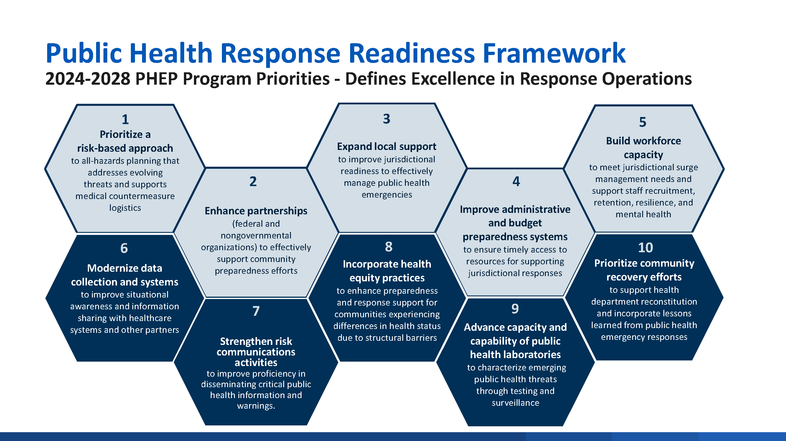
Notes:
Use honeycomb as a lens to apply capabilities.

Slide 21
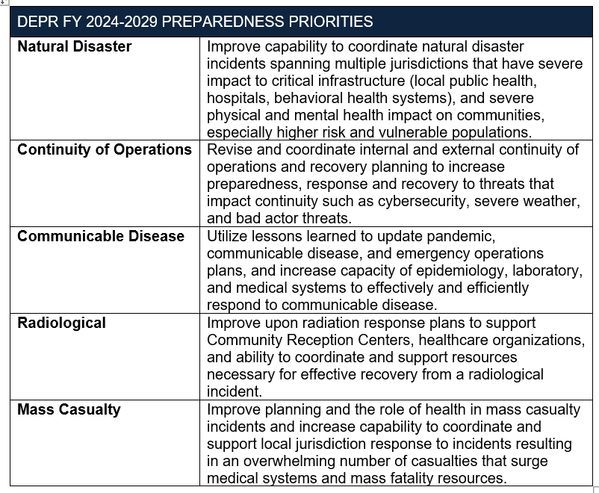
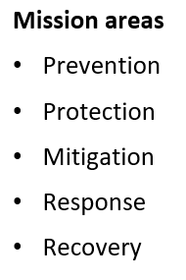

Slide 22
Preparedness Priorities
Preparedness priorities guide the overall direction of a step-wise exercise program, ensuring that individual exercises are aligned with common objectives and build toward increasing complexity over time.

Slide 23
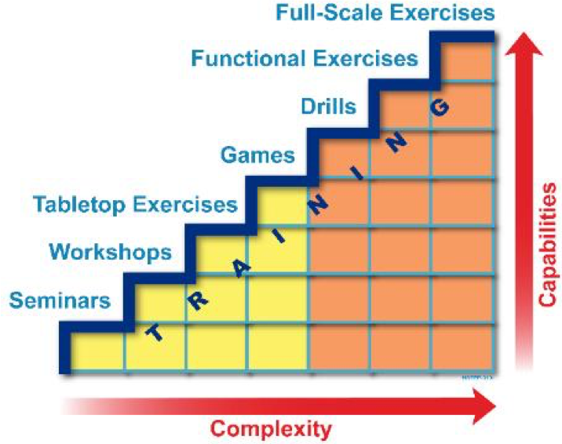
Increasing Complexity
Notes:
Not only do we want our exercises to increase in complexity and involve more capability, it is vitally important that we include training as we progress.
Discuss an example of an exercise where little to no training was completed prior to the event. Airport.

Slide 24
The Dominoes
Factors – What makes things better or worse
Capabilities – What we could do
Priorities – What we need to do
Plans – What we intend to do
Training – How we get our message out
Exercises – What are we doing
Evaluation – What can we do better
WHAT HAPPENS NEXT?
Notes:
Plans need the stuff to make them work.
Stuff takes money to purchase.

Slide 25
Background
Integrated Preparedness Planning Cycle defined:
A continuous process of planning, organizing/equipping, training, exercising, and evaluating/improving that ensures the regular examination of ever-changing threats, hazards, and risks.
Notes:
The presenter reviews updates to the HSEEP doctrine (2020), including broader definitions of capabilities and leadership, and the intent to simplify doctrine and templates.

Slide 26
Background
Integrated Preparedness Plan defined:
A document for combining efforts across components of the Integrated Preparedness Cycle to make sure that a jurisdiction/ organization has the capabilities to handle threats and hazards. The IPP allows for a more deliberate approach to multi-year preparedness activity planning.
Notes:
The presenter reviews updates to the HSEEP doctrine (2020), including broader definitions of capabilities and leadership, and the intent to simplify doctrine and templates.

Slide 27
The IPPW
What is an IPPW?
The IPPW is a meeting held (annually) to establish the strategy and structure for an exercise program, in addition to broader preparedness efforts, while setting the foundation for the planning, conduct, and evaluation of individual exercises.

Slide 28
The IPPW
Goals of an IPPW?
SET preparedness priorities
DEVELOP a plan document
CREATE a multi-year schedule
ESTABLISH program reporting
BUILD relationships

Slide 29
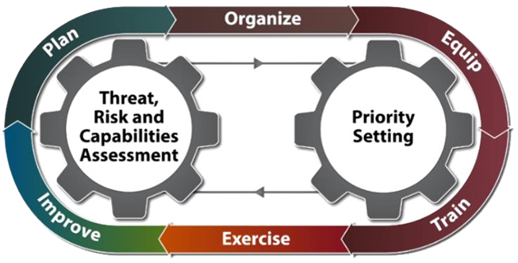
POETE(E) Cycle
Notes:
The Preparedness Cycle is based upon the core steps of utilizing threat, hazard, risk and capability assessments and preparedness deliverables to set program priorities. Once priorities are determined, addressing how to plan, organize, equip, train, exercise, and evaluate and improve forms the process used to close gaps, address weaknesses, and increase efficiencies. This becomes a continuous and ever improving cycle that builds upon prior improvements and efficiencies.
A perfect example of this is cycle is to look at communications related to emergencies over the years. New technologies can be adopted to improve process, increase effectiveness, and increase efficiency.
The purpose of the Integrated Preparedness Plan (IPP) is to document overall preparedness priorities and activities for your jurisdiction or organization.
Incorporating all elements of the Integrated Preparedness Cycle allows for maximum efficiency of resources, time, and funding.
Allows work toward improving your
jurisdiction’s/organization’s capabilities

Slide 30

Development
The Integrated Preparedness Workshop (IPPW)

Slide 31
POETE Cycle Applied to IPPW
PLAN
Understand the material (AARs, IPs, HVAs, Prior plan, grant requirements….)
Determine: Who what, where why, when how, how much
Make sure not to conflict with other events
Food
ORGANIZE
Operationalize the plan
Develop materials
Establish deadlines

Slide 32
POETE Cycle Applied to IPPW
EQUIP
Send invites
Finalize templates and references
TRAIN
Have a kickoff meeting
Cover expectations
Cover deadlines
Provide templates/examples

Slide 33
POETE Cycle Applied to IPPW
EXERCISE (Conduct)
Pre-event set up
Provide structure and guidance
Group participants and then adjust groups
Evaluate/Improve
Take notes
Assign evaluators
Notes:
Our end goals will be to integrate:
Between organizations
between disciplines
between jurisdictions
between program areas
between program requirements, identified gaps, and known and potential risks

Slide 34
Common IPPW Agenda
•
[Time]
Integrated Preparedness Overview
•
[Time]
Review of Prior Integrated Preparedness
Plan
•
[Time]
Identify Preparedness Priority Factors
•
[Time]
Establish Preparedness Priorities
•
[Time]
Develop a Multi-year Schedule
•
[Time]
Establish Program Reporting
•
[Time]
Review
•
[Time]
Next Steps
•
[Time]
Closing Remarks
Notes:
The presenter explains what an IPPW is, its frequency, and its purpose—to use senior leader guidance and whole-community participation to set preparedness priorities.

Slide 35
Review of Prior Integrated Preparedness Plan (IPP)
Provide highlights from the previous multi-year IPP and an update on the progress toward the preparedness priorities and the multi-year schedule

Slide 36
Integrated Preparedness Schedule
•
[Month 1]
Activity | Priority 1 | Priority 2 | Priority 3 | Priority 4 | Priority 5
Plan
Organize
Equip
Train
Exercise
Example schedule only
Duplicated for months 2, 3, 4, etc

Slide 37
Example Exercise Schedule

Slide 38
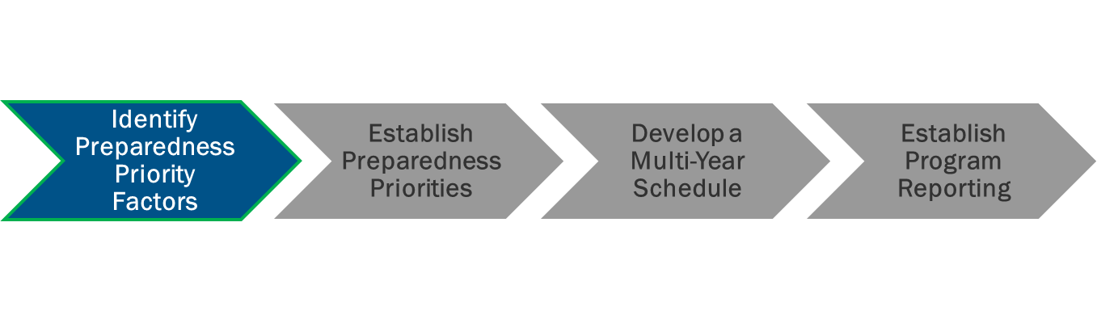
Identify Preparedness Priority Factors
“Factors” = the things that help or hinder your preparedness.
Don’t focus only on training and exercises. Consider plans, purchases, relationship building, developing new partnerships.
Notes:
Discuss communications challenges at multiple exercises that are documented in AARs and Improvement plans.

Slide 39
Identify Threats, Hazards, and Risks
Instructions:
Locate the other members of your
jurisdiction/organization
As a group, develop a list of the top threats, hazards, and risks impacting your jurisdiction/organization
Record these threats, hazards, and risks
Choose a group member to brief the findings
Objective: Identify any significant threats, hazards, and risks
Consider:
Jurisdiction/Organization threats and hazards
THIRA or other local risk assessments
Hazard vulnerability analysis
National threats and hazards

Slide 40
Identify Areas for Improvement and Capabilities Assessments
Objective: Identify areas for improvement and assess current capabilities
Consider:
Previous areas for improvement and capability assessments identified
Prioritized corrective actions
Newly acquired capabilities and resources
Completed corrective actions validated
Strengths shared
Instructions:
Locate the other members of your jurisdiction/organization
As a group, develop a list of your
Top strengths and areas for improvement
Record these strengths/areas for improvement
Choose a group member to brief the findings

Slide 41
Identify External Sources and Requirements
Instructions:
Locate the other members of your
jurisdiction/organization
As a group, develop a list of your
Key external sources and requirements
Record these sources and requirements
Choose a group member to brief
the findings
Objective: Identify any significant external sources and requirements
Consider:
Industry reports
State or national preparedness reports
Homeland security strategies
Grants or funding-specific requirements

Slide 42
Identify Accreditation Standards and Regulations
Instructions:
Locate the other members of your jurisdiction/organization
As a group, develop a list of your key accreditation standards and regulations
Record these standards and regulations
Choose a group member to brief the
findings
Objective: Identify any significant accreditation standards and regulations
Consider:
Accreditation requirements
Local, state, and federal regulations

Slide 43

Establish Preparedness Priorities
Preparedness priorities are the strategic, high-level priorities that guide overall preparedness activities
These priorities should be comprehensive to meet the needs of the whole community and will drive preparedness activities through the Integrated Preparedness Cycle
Notes:
While you will have many factors which impact preparedness, you need to set broad priorities which are strategic and that will guide progress.

Slide 44
Establish Exercise Program Priorities
Instructions:
Identify appropriate number of priorities on which to focus upcoming preparedness activities
Priorities should action orientated and measurable
Consider priorities from a holistic preparedness perspective
Objective: Achieve consensus on the priorities that will guide the preparedness activities for the next 4 years
Consider:
Factors
Senior Leaders’ guidance

Slide 45
Identify Planning Elements
Instructions:
Locate the other members of your
jurisdiction/organization
As a group, discuss what plans, policies, procedures, and checklists will be reviewed, updated, or written in the next 4 years
Record the results of the discussion
Choose a group member to brief the
findings
Objective: Identify planning activities affecting preparedness priorities
Consider:
Existing planning goals or deadlines
Existing corrective actions to be
integrated into plans
Information needed on jurisdictional/organizational factors
Training needed for existing plans, policies, procedures, and checklists

Slide 46
Identify Organizing Structure Elements
Instructions:
Locate the other members of your
jurisdiction/organization
As a group, discuss jurisdiction/organization structure changes for the next 4 years
Record results of the discussion
Choose a group member to brief the findings
Objective: Identify organization activities affecting preparedness priorities
Consider:
New organizational structure changes, shortfalls, and limiting factors
Upcoming budget, grants, retirements, staff turnover, long term vacancies
Training needed to address organizational structure and capabilities changes

Slide 47


Identify Equipment Elements
Instructions:
Locate the other members of your
jurisdiction/organization
As a group, discuss equipment changes for the next 4 years
Objective: Identify equipment activities affecting preparedness priorities
Consider:
New equipment, shortfalls, and limiting
factors
Upcoming budget, grants, purchase approvals,
Training needed to improve or introduce equipment capabilities
Record results of the discussion
Choose a group member to brief the findings

Slide 48

Activity 3: Develop a Multi-Year Schedule
The purpose of this activity is to schedule and synchronize all aspects of preparedness within the Integrated Preparedness Cycle, not just training and exercises, in an effort to address capability gaps and improve overall preparedness.

Slide 49
Identify Potential Training
Instructions:
Locate the other members of your
jurisdiction/organization
As a group, identify potential training events
Record the potential training events, including the focus, audience, and date
Choose a group member to brief the findings
Objective: Identify potential training priorities and opportunities for inclusion in the multi-year schedule
Consider:
Current training capabilities and planned courses
Jurisdictional/Organizational customized training
Recurring training requirements
Training needed to close gaps
Training needs prior to exercises
Training options available

Slide 50
Identify Potential Exercises
Objective: As a group, identify potential
exercises for inclusion in the multi-year schedule
Consider:
What changes to plans, policies, procedures, and checklists need validating?
What jurisdictions/organizations, departments, and
teams need exercising and in what way?
Does equipment usage need validating?
What training is needed prior to exercising? Identify training.
What previous corrective actions need to be validated?
What types of exercises will meet needs?
What is the goal or intended outcome of the chosen exercises?
Instructions:
Locate the other members of your jurisdiction/organization
As a group, identify potential exercises
Record the potential exercises events, including the focus, audience, and date
Choose a group member to brief the findings.

Slide 51
Update/Build the Multi-Year Schedule
Instructions:
Populate planning activities identified
Select organize/equip activities identified to populate in the multi-year schedule
Select exercises from the proposed list and
identify tentative exercise conduct dates
Select training events and identify tentative conduct dates, scheduling around planning, organize/equip, and exercises, as appropriate
Objective: Update or build the multi- year schedule of preparedness activities
Consider:
Preparedness factors identified in previous tasks (plan, organize/equip, train, exercise, and improve)
Activities that promote collaboration
Activities involving the Whole Community

Slide 52

Establish Program Reporting
Include the jurisdiction’s/organization’s methodology for prioritizing, assigning, monitoring, tracking, and reporting the progress made toward resolution of issues identified during exercises and real-world incidents.
Notes:
Divide activity into a series of meetings - Some virtual, some in-person
Disseminate an agenda and a request for participants to bring specified information, data, or resources
Include all levels of participants -“New” people perspective vs. “experienced” perspective

Slide 53
Next Steps
Develop and distribute IPPW Summary
Develop the IPP
Send participants home with a clear list of items to accomplish and a date for the next meeting
Notes:
The presenter instructs participants to develop the IPPW summary, draft the IPP, and identify action items with clear deadlines.

Slide 54

HSEEP Resources
The FEMA Prep Toolkit has existing IPPW materials that can be modified to help develop and conduct an IPPW.
Notes:
https://preptoolkit.fema.gov/web/hseep-resources/program-management

Slide 55

ASPR Resources
Healthcare Coalitions | ASPR TRACIE
GrantSolutions (NOFO)
Notes:
https://preptoolkit.fema.gov/web/hseep-resources/program-management

Slide 56
Contacts
Damon Obiden
obidend@michigan.gov
Larry Zimmerman
ZimmermanL1@michigan.gov
Notes:
Closing slide for appreciation and contact info.

