Slide 1

administrative preparedness – a team sport
Presented by Jenni Zordan
Van Buren/Cass District Health Department

Slide 2
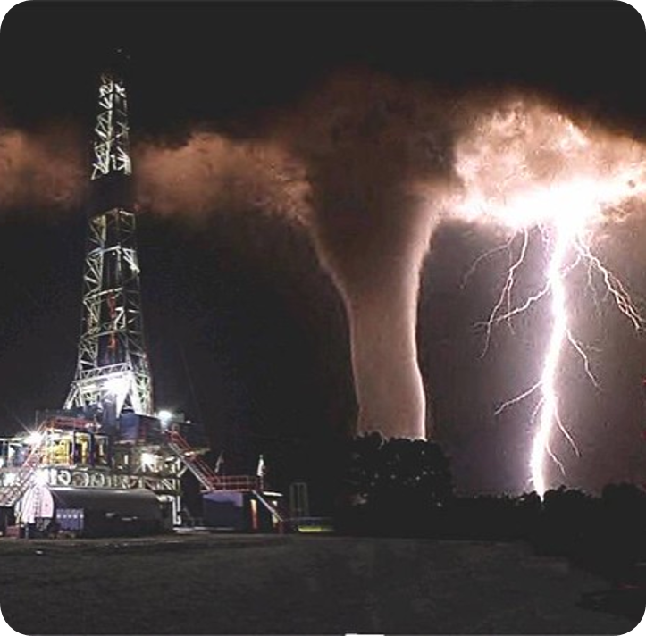
Agenda
What & Why
Plan contents
Q & A

Slide 3

What & Why
What is Administrative Preparedness?
  The process for ensuring that fiscal and administrative authorities and practices that govern funding, contracting, hiring, and legal capabilities necessary to mitigate, respond to, and recover from public health emergencies can be accelerated, modified, streamlined, and accountably managed at all levels of government.*
How does Administrative Preparedness help us?
Fill funding gaps created by an emergency
Fill staffing gaps with hiring or contracting
Skip "red tape" parts of purchasing/hiring procedures
Requirement of the PHEP Cooperative Agreement
*DEPARTMENT OF HEALTH AND HUMAN SERVICES, CENTERS FOR DISEASE CONTROL AND PREVENTION : HOSPITAL PREPAREDNESS PROGRAM (HPP) AND PUBLIC HEALTH EMERGENCY PREPAREDNESS (PHEP) COOPERATIVE AGREEMENTS, FUNDING OPPORTUNITY NUMBER: CDC-RFA-TP12-1201
Notes:
Administrative Preparedness is the process for ensuring fiscal (money) and administrative authorities and practices are in place that tell us how to hire, contract, receive and spend funding, halt funding expenditures, during public health emergencies. It helps us to fill funding gaps and staffing gaps created by an emergency, skip the red tape of some purchasing or hiring procedures or even reassign current personnel, and it is a REQUIREMENT OF THE PHEP AGREEMENT.

Slide 4

Public health administrative preparedness plans
Emergency Fiscal Authorities
Emergency Legal Authority
Administrative Preparedness
  Communication & Coordination
  Hiring and Staffing
  Procurement Processes (Resource Mangement)
  Contracting Procedures
Emergency Declarations
Training & Exercises
Notes:
A public health administrative preparedness plan typically includes several key components to ensure that fiscal, legal, and administrative processes are streamlined and effective during emergencies. Here are some of the main elements:
Fiscal Authorities: Ensuring that funding mechanisms are in place to quickly allocate resources during an emergency
Legal Authorities: Identifying and modifying legal and regulatory requirements that may impede rapid response efforts
Administrative Preparedness such as:
Communication and Coordination: Ensuring effective communication channels and coordination among various departments and agencies
Hiring and Staffing: Developing protocols for the swift hiring or reassignment of personnel to meet emergency needs
Procurement Processes: Establishing procedures for the rapid acquisition of necessary supplies and services
Contracting Procedures: Streamlining the process for creating and managing contracts with vendors and service providers
Emergency Declarations: Procedures for declaring emergencies to activate special administrative powers
Training and Exercises: Regularly conducting drills and exercises to test and improve administrative preparedness capabilities

Slide 5

Fiscal authority/Procurement
Federal
  CDC (PHEP funding)
  Other federal grants
State
  MDHHS
    PHEP/ELC/ ELPHS – Essential Public Health Services
        How we accept and allocate funds quickly?
    Procurement: MiDEAL/State purchasing contracts
Local
  County Appropriations
  Local Grants (United Way, Health Endowment Fund, etc)
Notes:
PHEP ELC Epi & Lab Capacity
We know how to accept and allocate federal and state funds, we do it everyday. Local apprpriations or county level funds are something different. Each county is different and funds the local health departments in different amounts and ways. Local grant funds are funds that may be available during normal operations, but what if they are not available during times of disaster? Or epidiemic
How many agencies were affected by the current funding cut to COVID/IMMS monies coming from the Federal govt.?
Procurement policies, utilizing State MiDeal allowing local governtment the power to purchase through specialized State Contracts; Authorized by Michigan Legislature since 1984

Slide 6

Public health law
Public Health Authority
  Public Health Code: PA 368 of 1978
    Imminent Danger
    Epidemic (emergency orders/procedures)
  Resources:
        MALPH: Advanced Public Health Law Workshop -July 8, July 9, July22, July 24
        National Public Health Law Conference - Seattle, WA September 2025
        The Network for Public Health Law (www.networkforphl.org)
        CDC Public Health Law
Notes:
Legal authority is granted to the State (the Governor, & MDHHS) and local health departments via the Public Health Code, Public Act 368 of 1978. It has been amended several times. It gives us authority to respond to imminent Danger (TB or HIV cases that could spread disease to others knowingly. We used the court supports often during the 1990’s to keep persons with HIV from spreading the disease to others without consent.
It also gives us Epidemic or emergency orders/procedures such as disease investigation, control and health education.
There are many resources we can use to develop our legal prepredness. The State of MI has been up front in leading legal preparedness for local and state public health. There have been course for judges and health officials, to explain to them the reason for emergency order and help them understand their importance. There is a new workshop supported by MALPH called the Advanced Public Health Law Workshop that just announced the Save the dates for workshops in the 4 corners of MI. Other resources are the National Public Health Law Conference, this year in Seattle, WA in September, and the Network for Public Health Law newsletter that comes out monthly. You can go to this website to sign up the newsletter. CDC has always provided local public health with the Public Health Law center for legal authority as well.
With many new health officers and political changes, be sure your agency is up to date with legal preparedness by attending one of these educational events.

Slide 7

Administrative preparedness:
Communication & coordination
Communication:
The process of exchanging information.
CERC Plans, Information Sharing, Public Information...
Joint Information Centers, press releases, internet, social media
Coordination
Builds trust and understanding between stakeholders, including government agencies, private sector, and the public.
Notes:
Administrative Preparedness Plans for communication revolve around policies and procedures. Do you have a policy to address social media during emergencies? Rumors? False statements made about your department? How and when do you share critical information about an emergency. Think about the current Measles outbreak – what are your procedures and policies about releasing information to neighboring jurisdictions, healthcare partners and the media? Are they different?
Coordination starts now, on the blue sky days! Building trust and understanding between stakeholders. We learned a lot during COVID days where communication well, wasn’t the greatest.

Slide 8

Administratvie preparedness:
Contracting procedures Hiring & Staffing
Written procedures for creating contracts
  Include in the contract how contracts are ended, especially in times of uncertainty (wide-spread disease outbreaks)
Contracting procedures may change in the approval process during emergencies – spell this out in your plan
Hiring & Staffing – what does this look like day-day
  How does this look during emergencies. Use real life examples to guide your procedures.
  Contract employee vs Staffing agencies
Notes:
Administrative Preparedness continues with contracting procedures for hiring and staffing.
During the COVID era – Did you use a staffing agency or volunteers or maybe you hired some extra help to do contract tracing. All of these things are out of the ordinary. What does your policy say about that? How do you cut the red tape here? Maybe you for-go the board approval for hiring certain positions, or using an agency to contract. Typically these type of decisions would need board of health approval. But what if your board doesn’t meet for another 2 weeks, can you wait that long? Do you need to have emergency board meetings?

Slide 9
“i have left orders to be awakened at any time during national emergency, even if I'm in a cabinet meeting.”
–Ronald Reagan
Notes:
There have been 90 Presidential National Emergency Declarations dating back to 1917 with President Woodrow Wilson. Many of the declarations revolve around international trade, economics or the military. Thinks shipping, and war. While others put sanctions on other counties such as South Africa, Libya, Panama, and Iraq. Weapons, chemicals and property have also been the subject of sanctions.
There are 49 of the declarations currently in effect, each having been renewed annually by the President. Dating back to 1979 when President Carter by executive order Blocking the Iranian Government Property, freezing of Iranian asssets as part of the US response during the Iran Hostage Crisis. President Clinton issued declaration that provided control over the export of Weapons of Mass Destruction. Many of the ongoing declarations involve terrorism or terrorist events.
Public Health National Declarations included 2009 H1N1 response and the 2020 COVID-19 Outbreak.
Source: https://en.wikipedia.org/wiki/List_of_national_emergencies_in_the_United_States

Slide 10
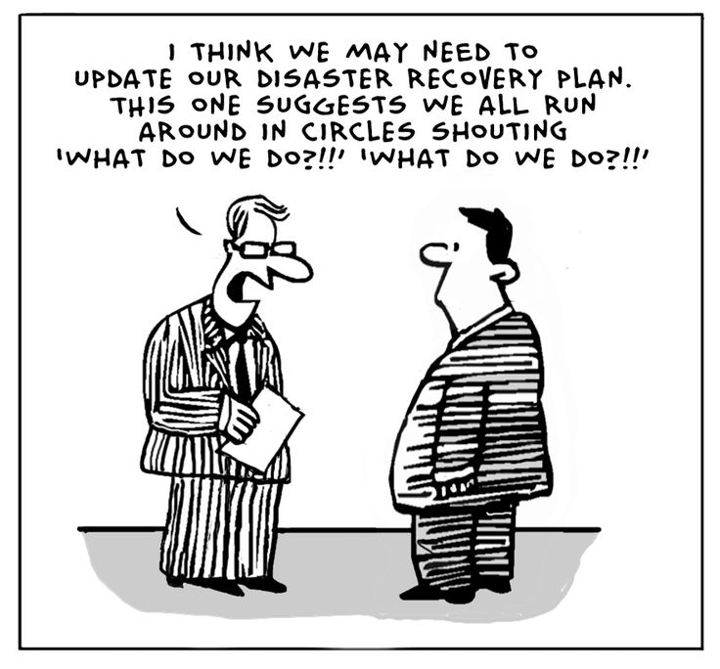

Emergency declarations
Emergencies begin
LOCAL
& end
LOCAL
Notes:
How many of you remember the Riots in Benton Harbor in 2003? A local State of Emergency was declared and more than 300 police officers took to the streets in riot gear. 2 nights of riots ensued on the city with hundreds of residents smashing windows, overturning cars and setting buildings on fire. One person was and 15 were injured during the chaos. This was a Local state of emergency. Granted by the governor to reassign Michigan State Police and the National Guard to respond. More recently the ice storms of northern Michigan caused a local state of emergency for some areas of the state. Other local emergencies include areas hit by severe storms or tornados, flooding

Slide 11
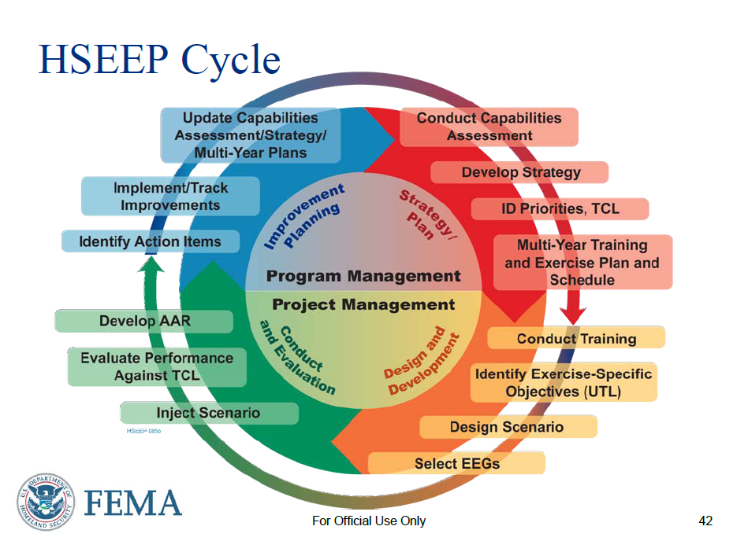
Training & exercise
Include Administrative Preparedness into training & exercises to ensure that the necessary administrative and legal framework is in place to support effective emergency response.
This helps to streamline processes, improve coordination and enhance public health resilience.
NACCHO Administrative Preparedness Guidebook
Public Health Emergency Exercise Toolkit -- CIDRAP
FEMA.gov (IS courses)
Notes:
Include Administrative Preparedness into training & exercises to ensure that the necessary administrative and legal framework is in place to support effective emergency response.
This helps to streamline processes, improve coordination and enhance public health resilience.

Slide 12
Notes:
Lets look at that cycle a little closer:
During your capabilities assessment – look at your administrative supports, policies, and procedures
During the construction of your Integrated Preparedness Plan – incorporate Administrative practices into your training & exercises. Public Health Law training. We are doing radiological training for department. I will be exercising our new human resource position with gap filling of staff for opening of decontamination centers and staffing the EOC. Our health officer will be working closely with county commissioners discussing the fiscal responsibilities of the county and the power plant. All of these things happen behind the scenes – be sure to document them. Track your actions in the After Action Reports and put those identified risks into your improvement plan.

Slide 13





Notes:
Just a few quotes about planning….

Slide 14

Questions
Jennifer Zordan, BS, CHES, PEM
Van Buren/Cass District Health Department
Jzordan@vbcassdhd.org
269-621-5504

